Slide 1
Modes of Operations of Block Ciphers Video Lectures Available at https://drive.google.com/drive/folders/1vs9oXRkoNj5XMtsOvKqi_547xvrfxQzl

Slide 2
Review of Block Cipher
We talked about three algorithms
DES
3DES
AES
These three algorithms are approximately 90% from the usage/application point of view.

Slide 3
Applications
Internet
Databases
Smart cards
E-Passports

Slide 4
What else we can do with Block Cipher?
Encryption (we have already done it)
Stream Ciphers
PRNGs
HASH Functions
MACs (Message Authentication Codes)

Slide 5
What else we can do with Block Cipher?
Do you remember the size of plain text and cipher text of the used algorithms?
DES !!!
64 bits of input and 64 bits of output
3DES!!!
64 bits of input and 64 bits of output
AES!!!
128 bits of input and 128 bits of output

Slide 6
How would you encrypt a PDF file of size 1 MB?
We will use “Modes of Operations of Block Ciphers

Slide 7
Modes of Operations
Electronic Code Book mode (ECB),
Cipher Block Chaining mode (CBC),
Cipher Feedback mode (CFB),
Output Feedback mode (OFB),
Counter mode (CTR).

Slide 8
Modes of Operations
Modes
Deterministic
(fixed)
Probabilistic
(Some degree of randomness)
Block Cipher
(CBC)
Stream Cipher
(OFB)
(CFB)
(CTR)
ECB

Slide 9
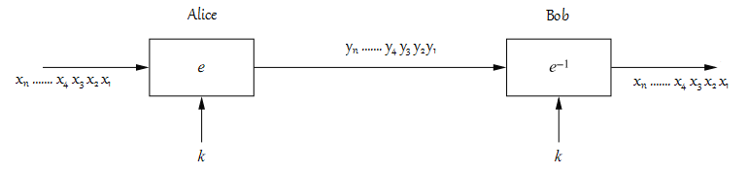
Electronic Code Book Mode (ECB)
Deterministic – pre-determined
Fixed
Not a good approach to encrypt data

Slide 10
Electronic Code Book Mode (ECB)
Attack on ECB Mode
Artificial Problem (just to provide an idea)
A basic example of electronic fund transfer

Slide 11
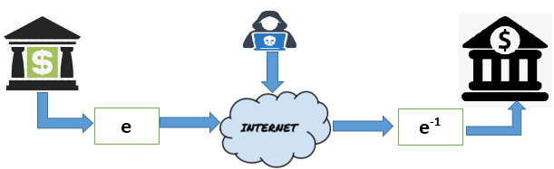
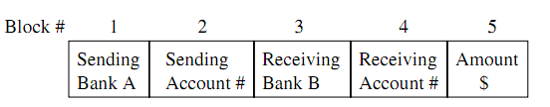
Electronic Code Book Mode (ECB)
Assumption 1: Each field is exactly n bits
Assumption 2: K is fixed for some time like an hour

Slide 12
Electronic Code Book Mode (ECB)
The attacker, Oscar, opens one account at bank A and one at bank B.
Oscar taps the encrypted line of the banking communication network.
He sends $1.00 transfers from his account at bank A to his account at bank B repeatedly. He observes the ciphertexts going through the communication network. Even though he cannot decipher the random-looking ciphertext blocks, he can check for ciphertext blocks that repeat. After a while he can recognize the ﬁve blocks of his own transfer. He now stores blocks 1, 3 and 4 of these transfers. These are the encrypted versions of the ID numbers of both banks as well as the encrypted version of his account at bank B.
Recall that the two banks do not change the key too frequently. This means that the same key is used for several other transfers between bank A and B. By comparing blocks 1 and 3 of all subsequent messages with the ones he has stored, Oscar recognizes all transfers that are made from some account at bank A to some account at bank B. He now simply replaces block 4 — which contains the receiving account number — with the block 4 that he stored before. This block contains Oscar’s account number in encrypted form. As a consequence, all transfers from some account of bank A to some account of bank B are redirected to go into Oscar’s B account! Note that bank B now has means of detecting that the block 4 has been replaced in some of the transfers it receives.
Withdraw money from bank B quickly and ﬂy to a country that has a relaxed attitude about the extradition of white-collar criminals
.

Slide 13
Cipher Block Chaining Mode (CBC)
Make encryption probabilistic
Combine encryption of all blocks
An encryption is deterministic if a particular plain text is mapped to a fixed cipher text if the key is unchanged
A probabilistic scheme use a randomness to achieve non-deterministic generation of cipher text

Slide 14
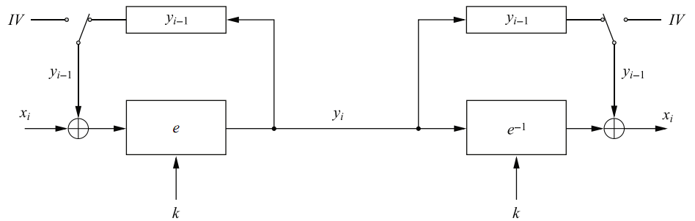
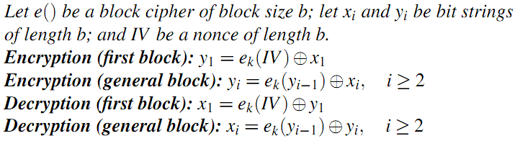
Cipher Block Chaining Mode (CBC)

Slide 15
Cipher Block Chaining Mode (CBC)
Properties of IV
Doesn’t have to be secret
Should be “no nce”
IV Generation
True random numbers
Use a counter of higher bits
Use IDs of Alice and Bob and time with some combinations

Slide 16
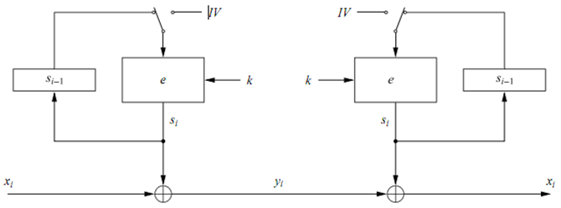
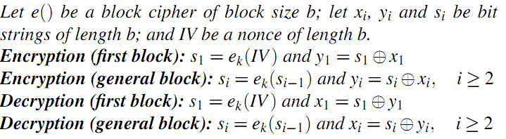
Output Feedback Mode (OFB)
Use block cipher as key stream generator:

